Slide 1

Ready2Meet Android Application Spring 2018
Berkay KÖKSAL

Slide 2
Idea
Facilitate creating events and inviting people
Provide tool for organizing the people joining the event
Interract with users based on location
Receive notifications on possible activities nearby

Slide 3
Business Model
Target users: Everyone
Development platform: only for Android (SDK 17+)
Marketing strategy:
Offer free events
Discounts for events
Gain as many users as possible

Slide 4
Monetization
Completely free to use
Possible joint event ticket sales with organisers
Advertisement inside the application (not the best option)
In-App sales:
Remove Ads
Premium Subscribtion (extra features)

Slide 5
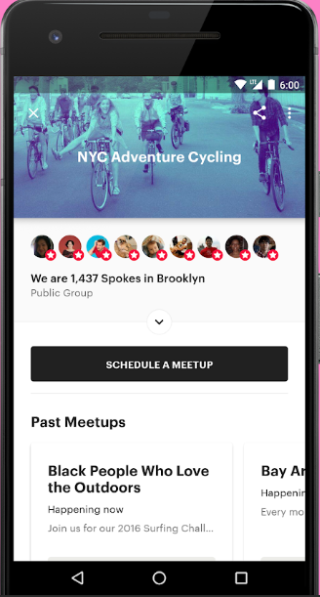

Competitors
MeetUp
Great suggestion system
Notification system is very good
But, it is group based not event based.
Individual users can’t create meetups
No direct interraction between users

Slide 6
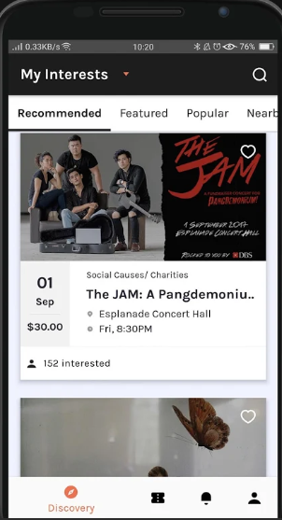

Competitors
BeScene
Great in app ticket sale system
Interconnected comments with Facebook
But, UI is not easy to use and again normal users can’t create events.

Slide 7
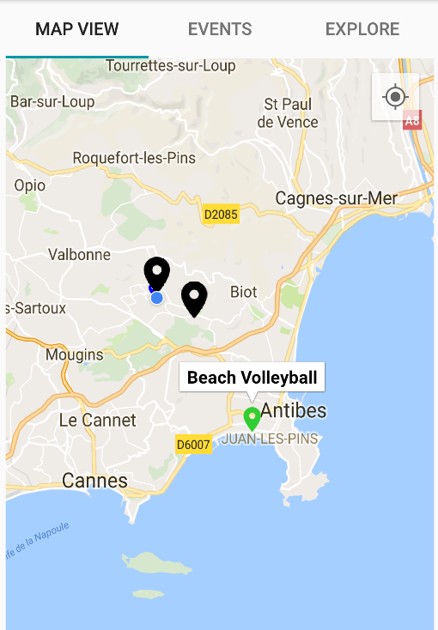
UI Design and Click Stream
Login Screen
Start Screen

Slide 8
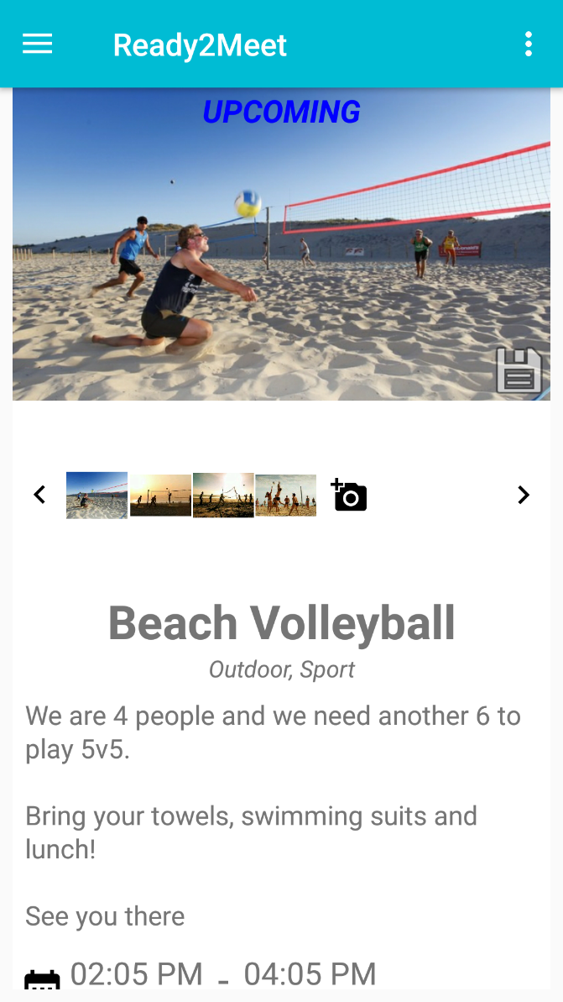
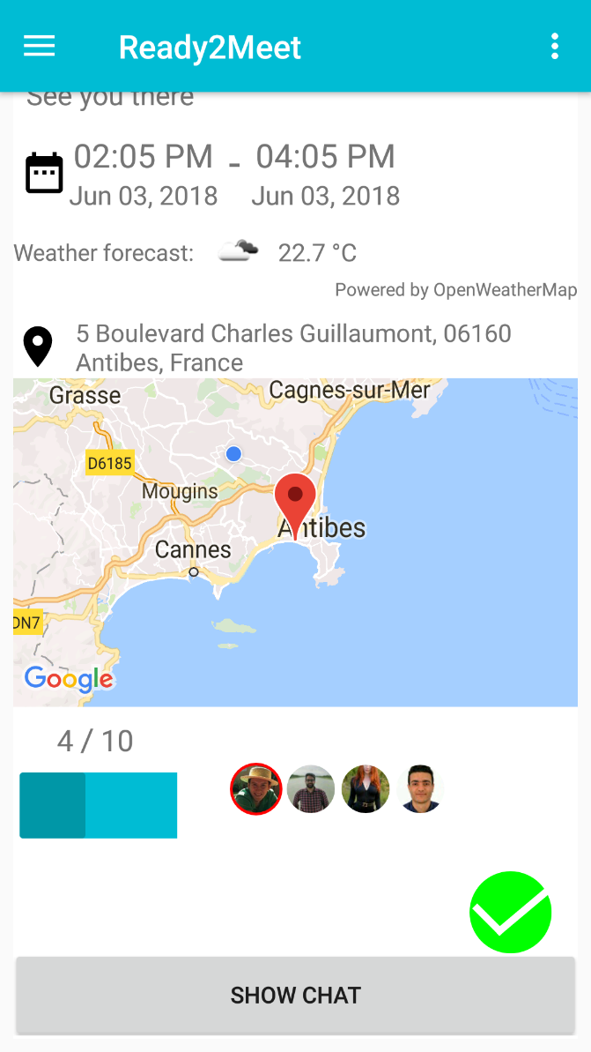
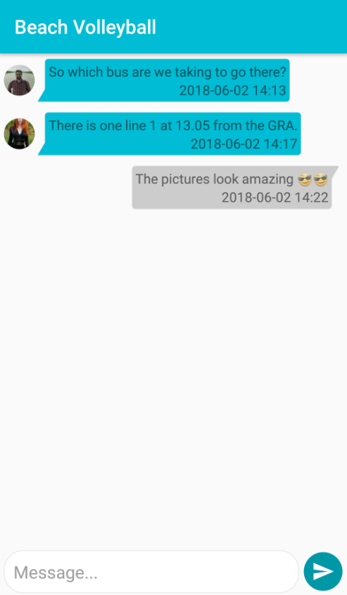
UI Design and Click Stream
Event Details 1
Event Details 2
Event Chat Room

Slide 9
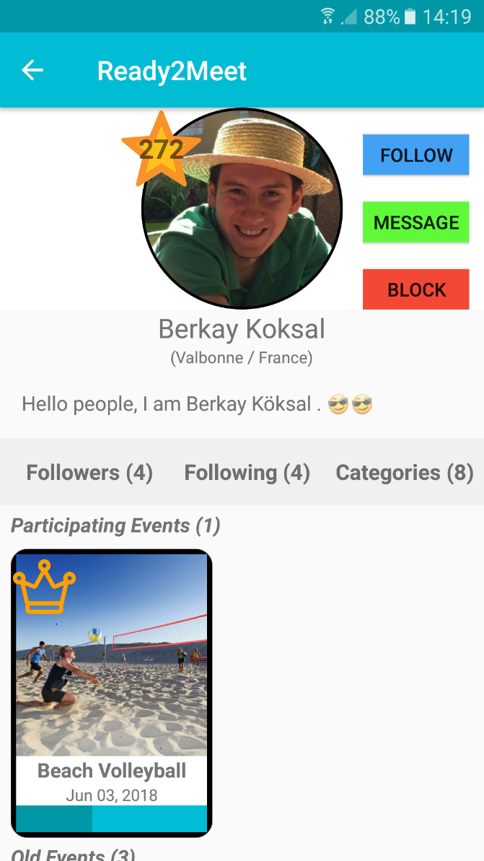
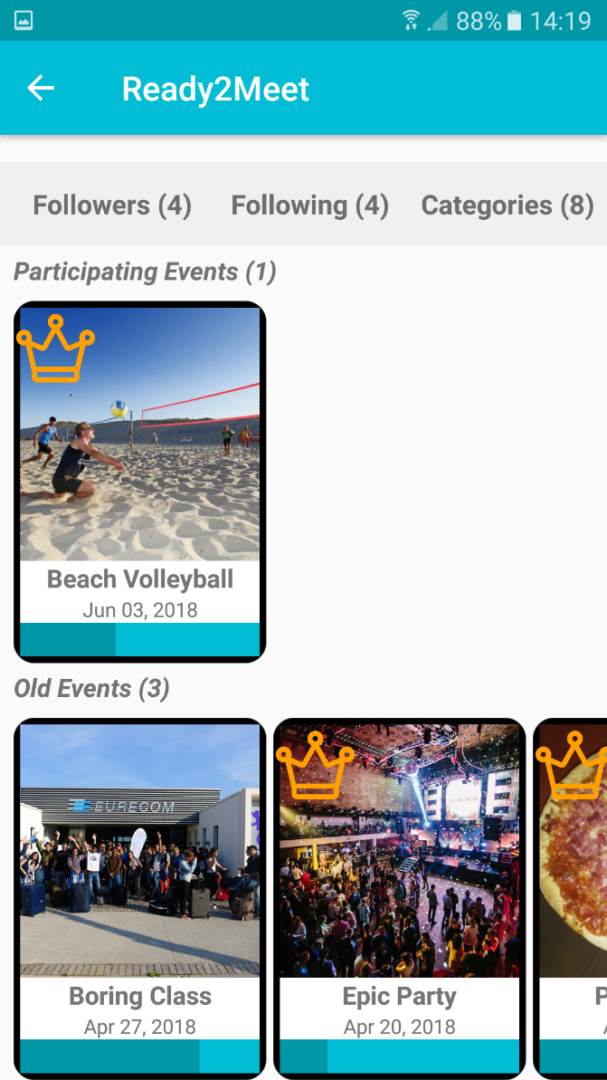
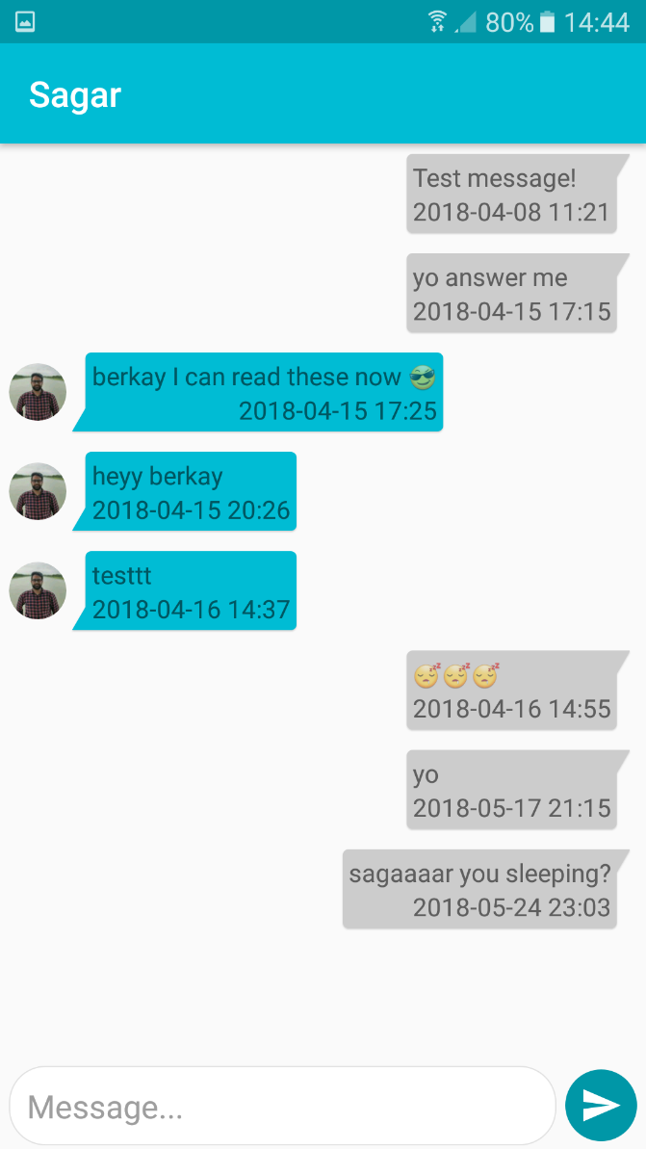
UI Design and Click Stream
User Profile 1
User Profile 2
User Chat Screen

Slide 10
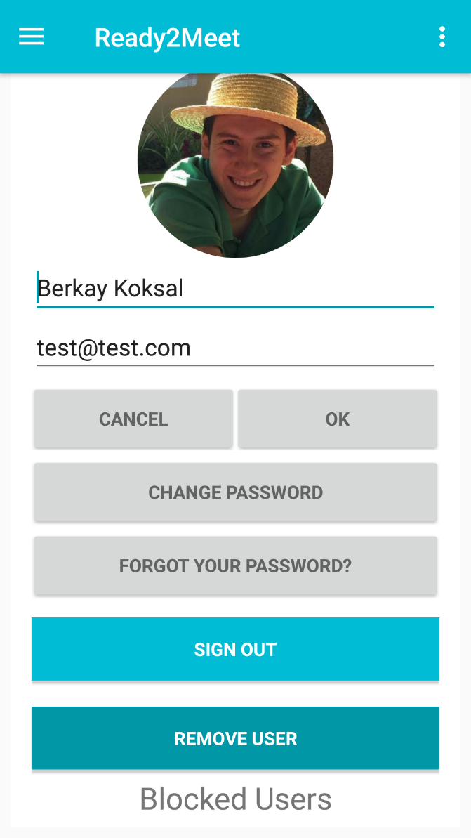
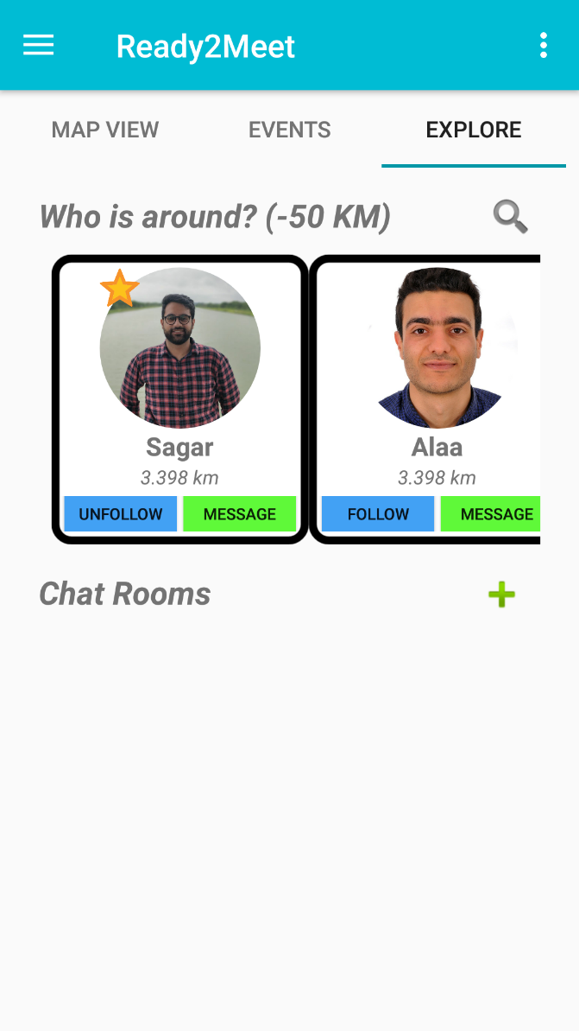
UI Design and Click Stream
Account Options
Explore View

Slide 11
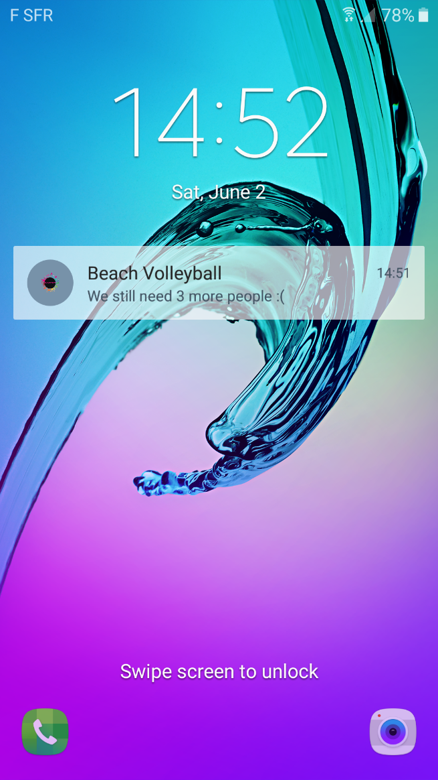
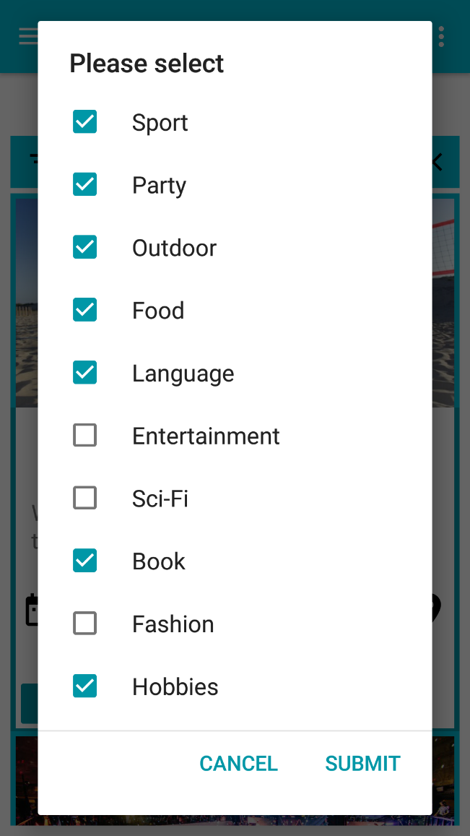
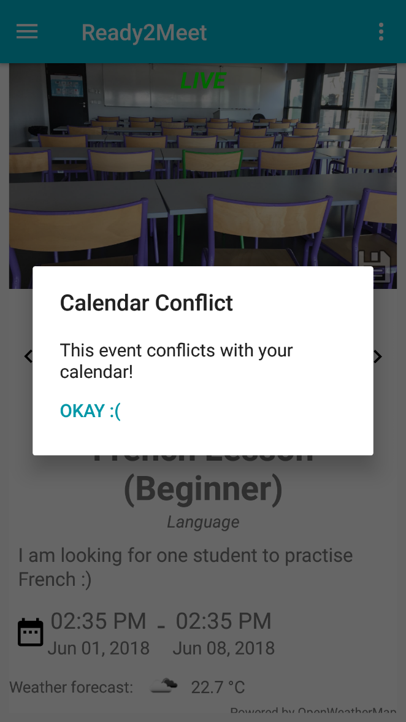
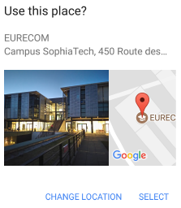
UI Design and Click Stream
Place Picker
Chat Notifications
Categories
Calendar Access

Slide 12
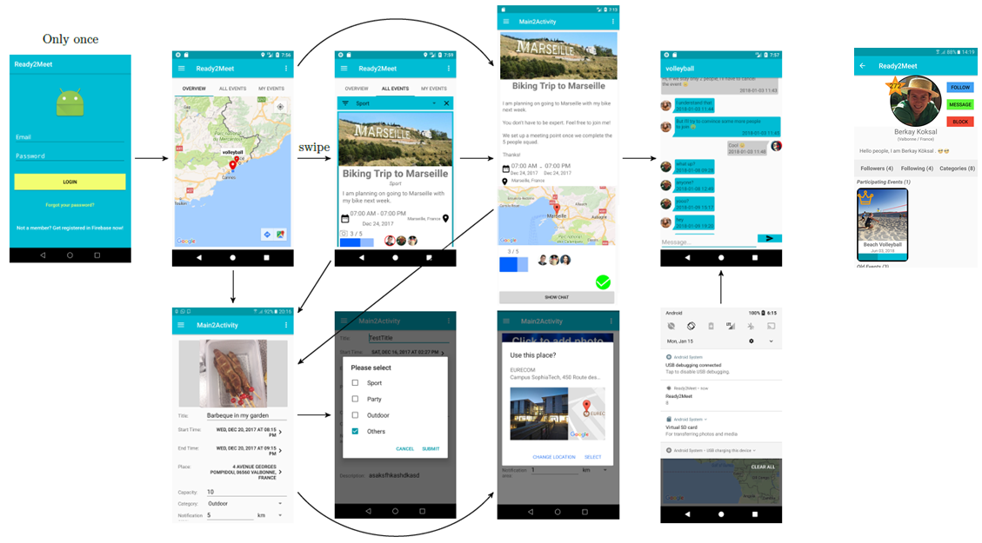


Slide 13
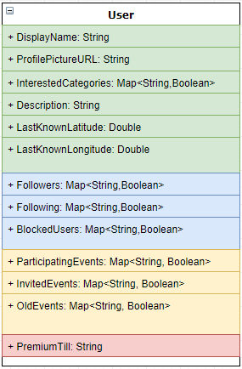
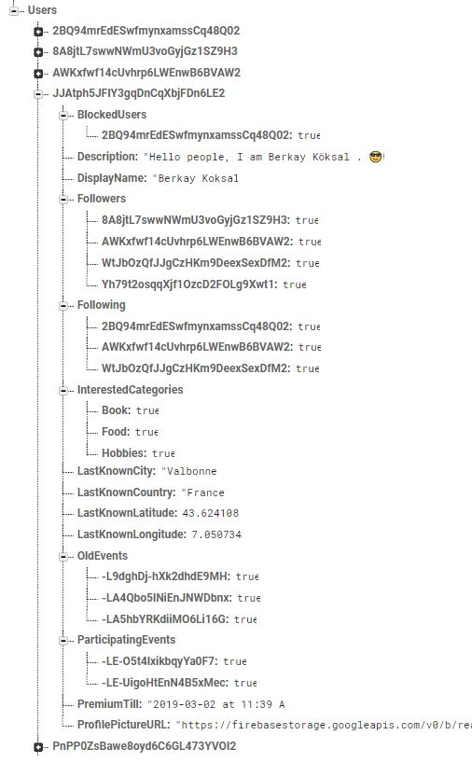
SW Architecture – Database

Slide 14
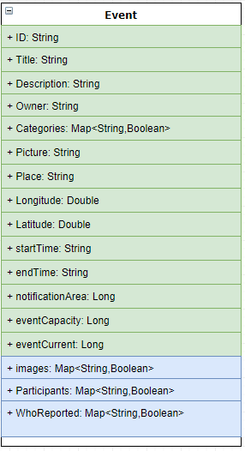
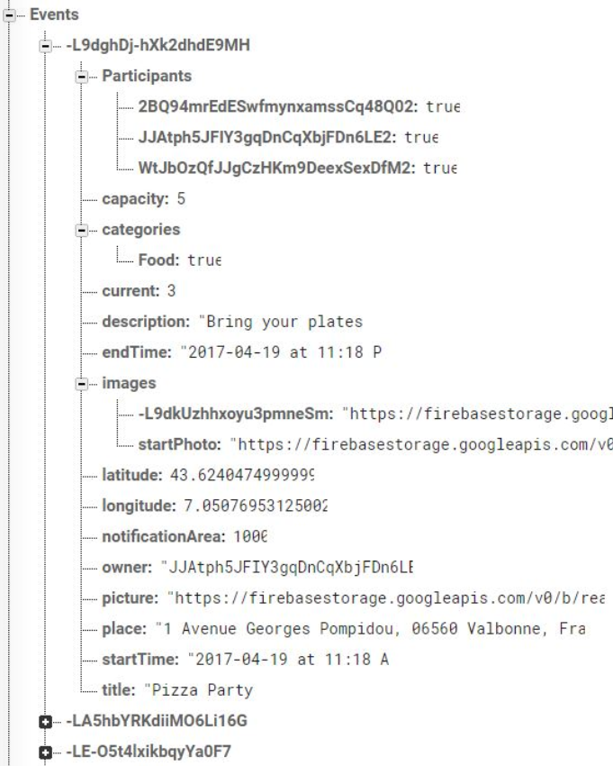
SW Architecture – Database

Slide 15
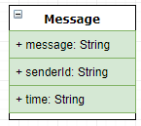
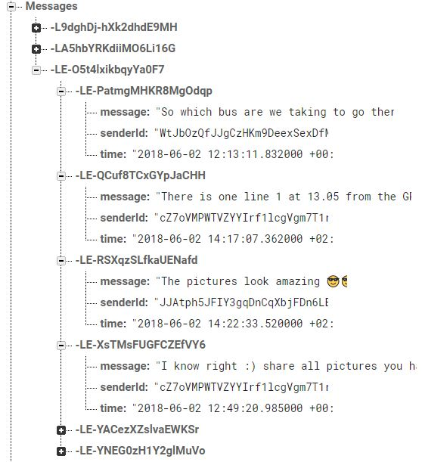
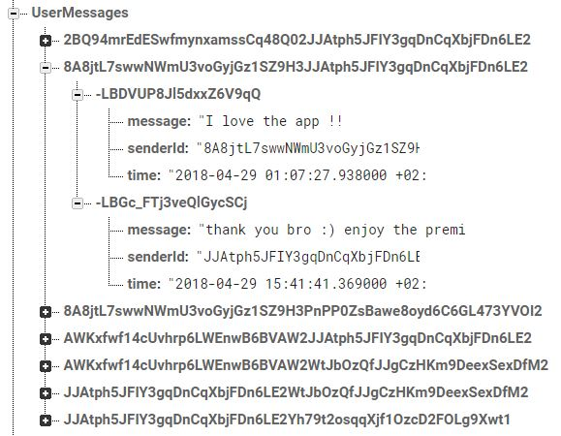
SW Architecture – Database

Slide 16
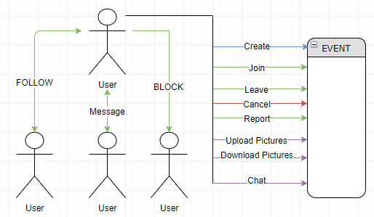
SW Architecture – Database

Slide 17
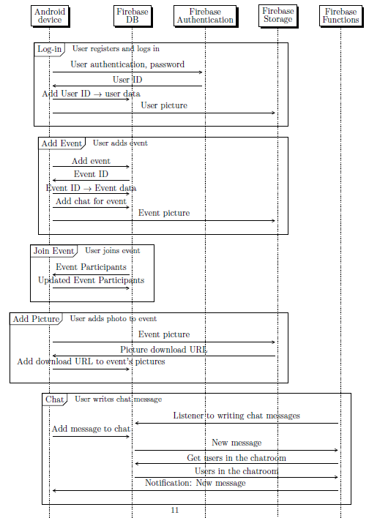
Firebase Services
Firebase Authentication
Firebase RealTime Database
Firebase Storage
Firebase Cloud Functions
Firebase Crashlytics

Slide 18
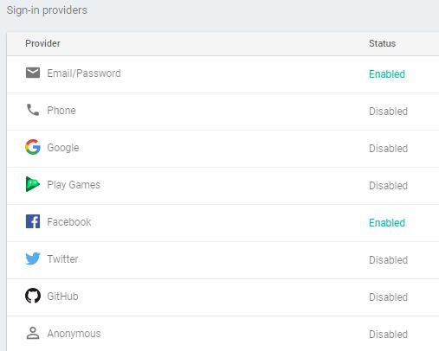
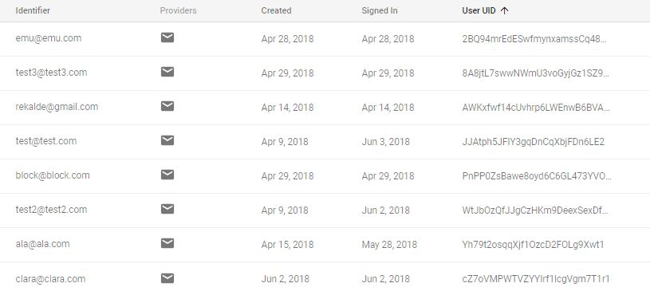
Firebase Authentication

Slide 19
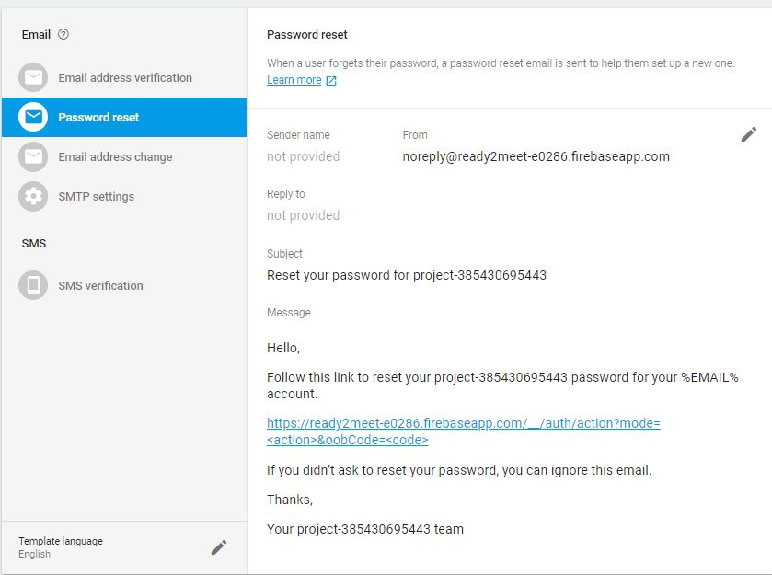
Firebase Authentication
Email Address verification
Password reset by mail
Email address change
SMS verification
Two Factor Authentication

Slide 20
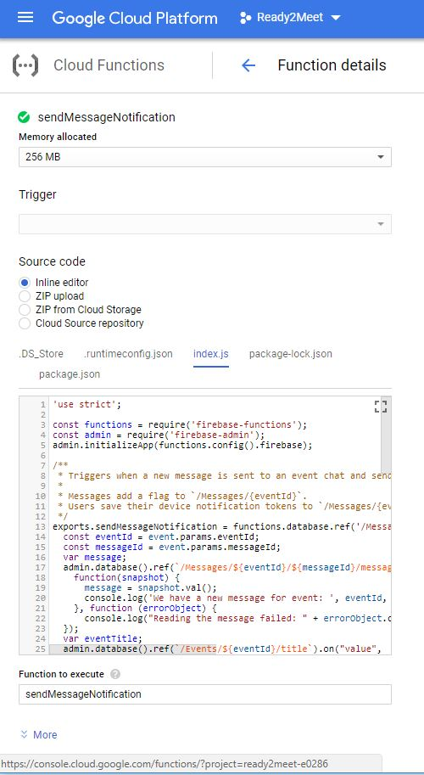
Firebase Cloud Functions
Cloud functions are used to set database triggers that listen changes on database, and take action to some certain changes.
These actions can be fired by the server and captured by devices to perform operations.

Slide 21
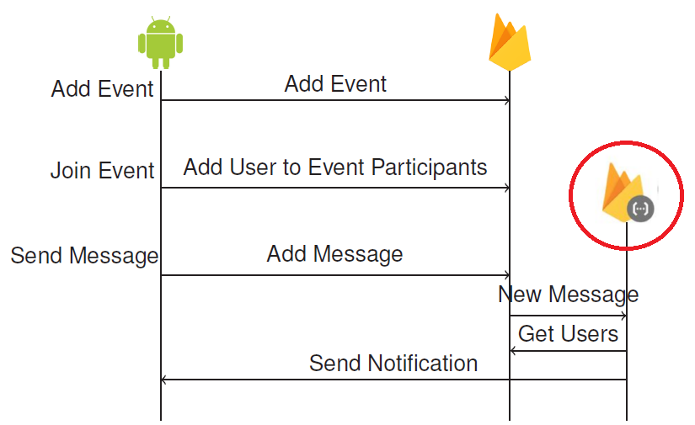
Firebase Cloud Functions

Slide 22
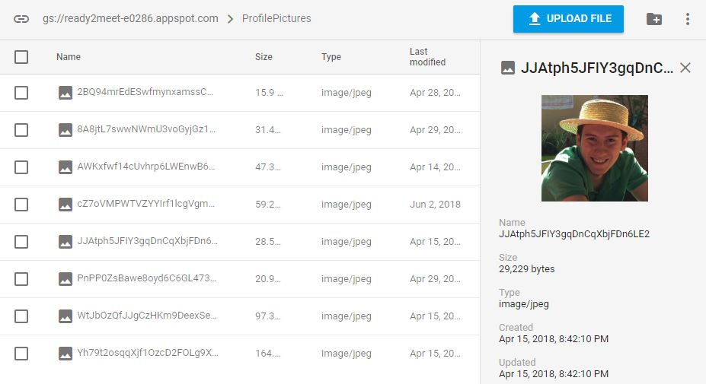
Firebase Storage
Profile Pictures are kept under Storage/ProfilePictures/USERID.jpeg

Slide 23
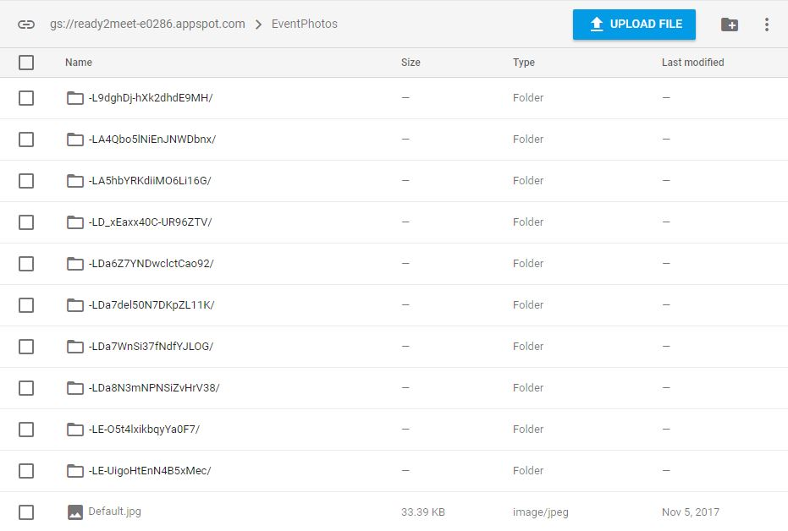
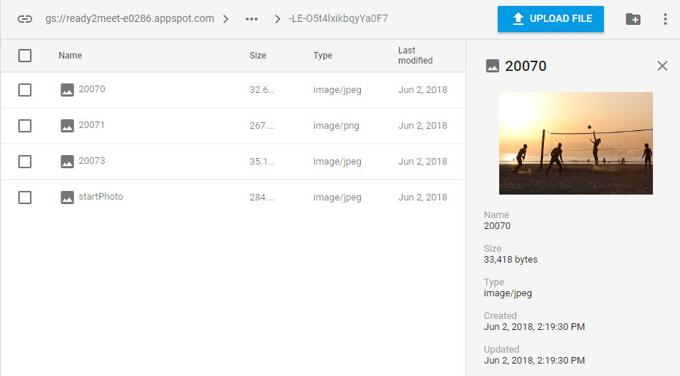
Firebase Storage
Event Pictures are kept under Storage/EventPhotos/EventID/*.jpeg

Slide 24
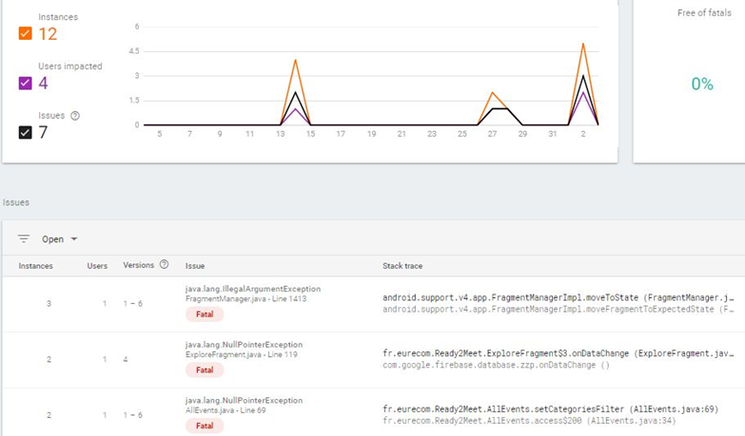
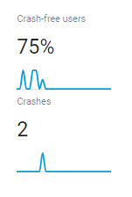
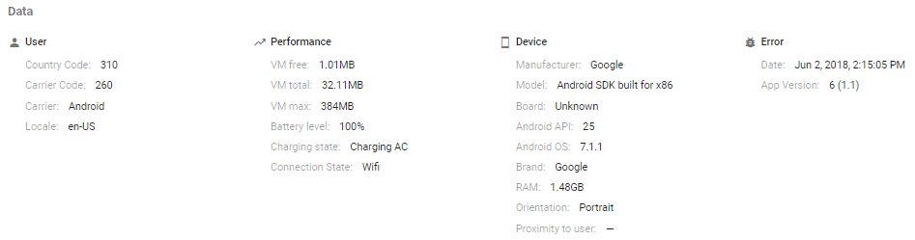
Firebase Crashlytics
Complete crash report
Complete console log
Line of code from apk
App version
Device Info
Model
SDK
Capacity
Device performance
Ram
VRAM
Battery
Connection type

Slide 25
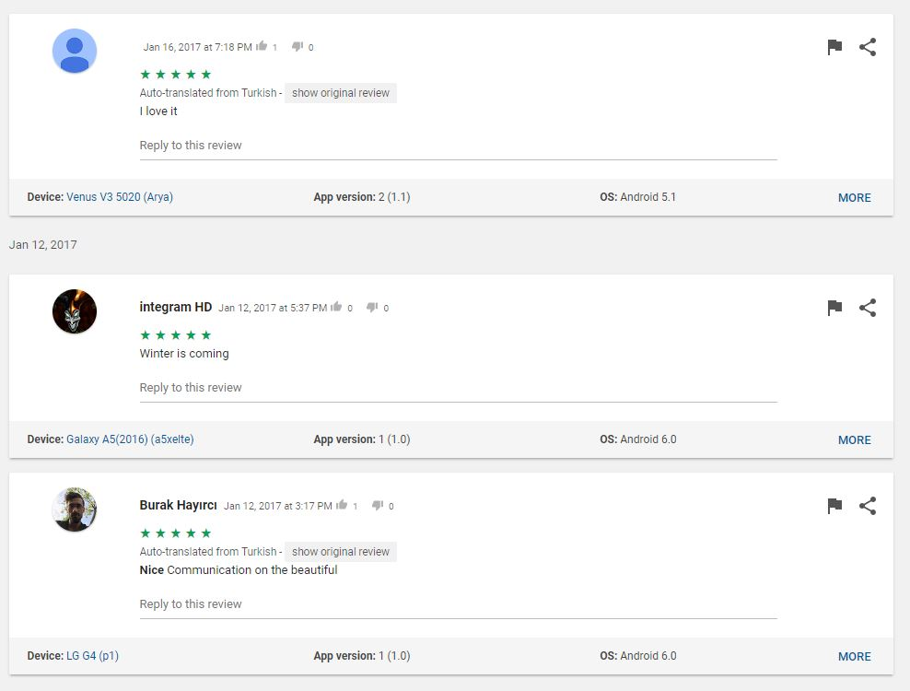
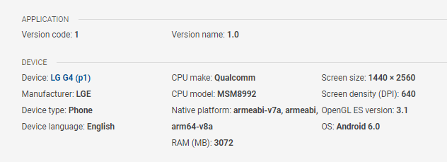
GooglePlay vs Firebase Crashlytics
User Review
App version
Device Info
Model
SDK
Capacity
THAT IS ALL?

Slide 26
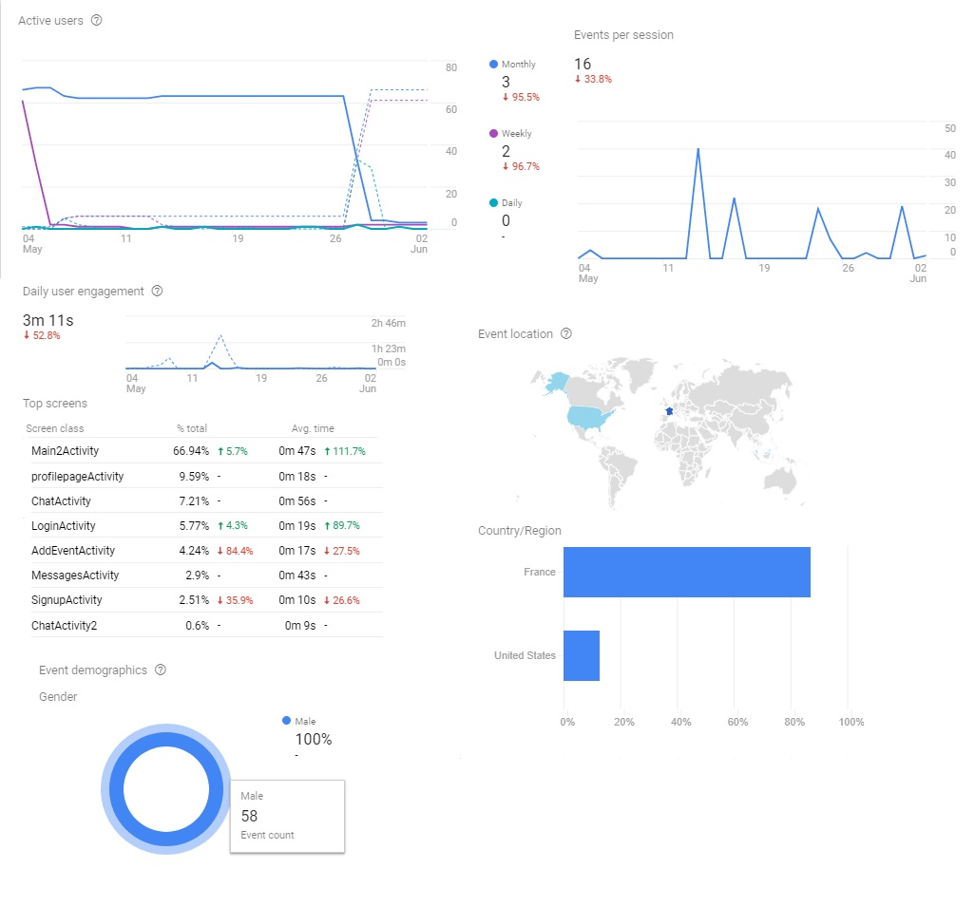
Firebase Statistics
Detailed monitoring over users.
Activity over time
Activity in the application
Clicks per session
Location analysis
Gender analysis
Interest analysis

Slide 27
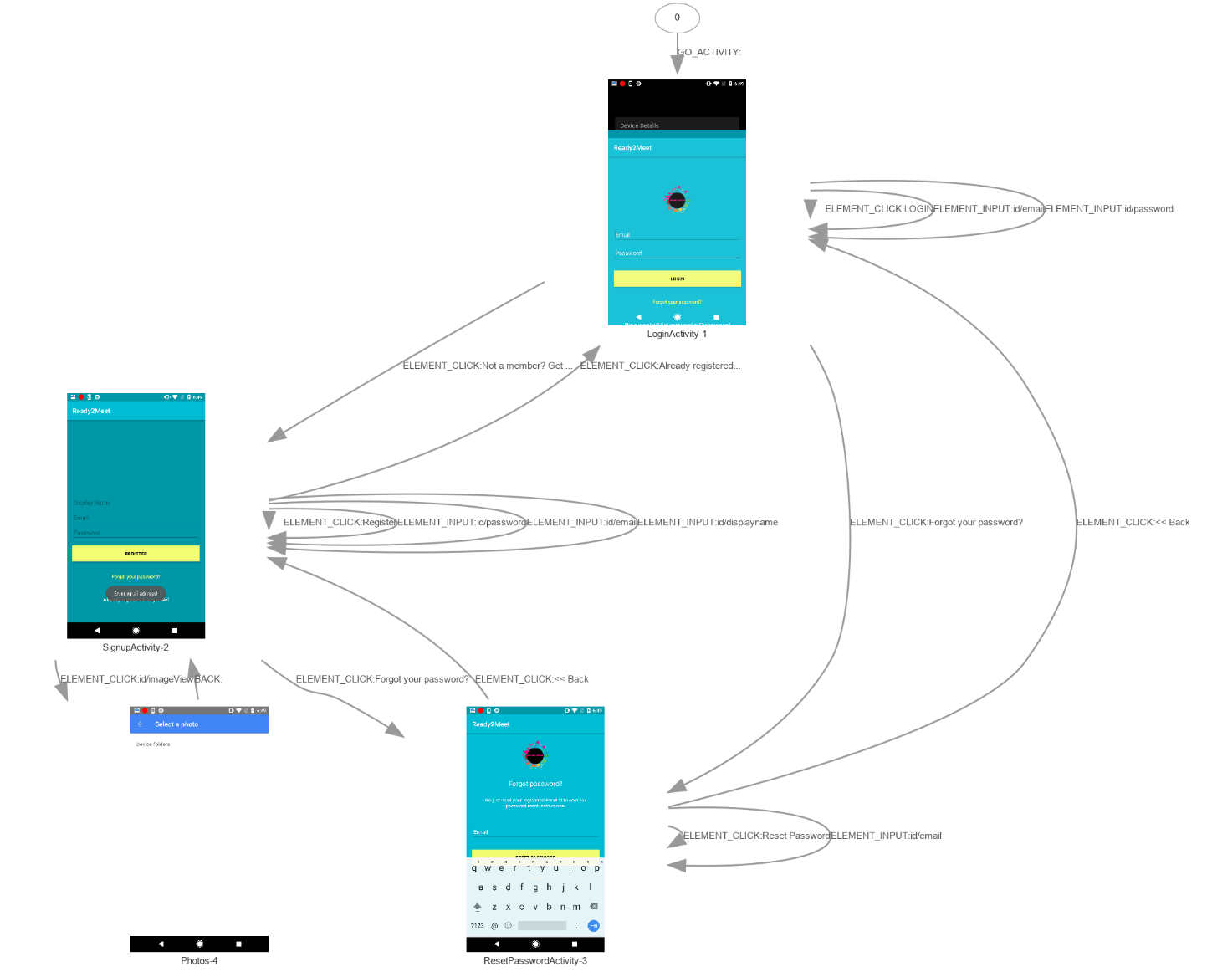
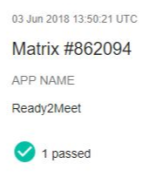
Firebase Test Lab

Slide 28
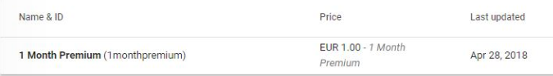
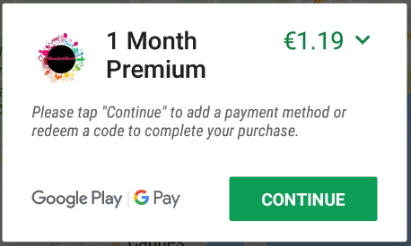
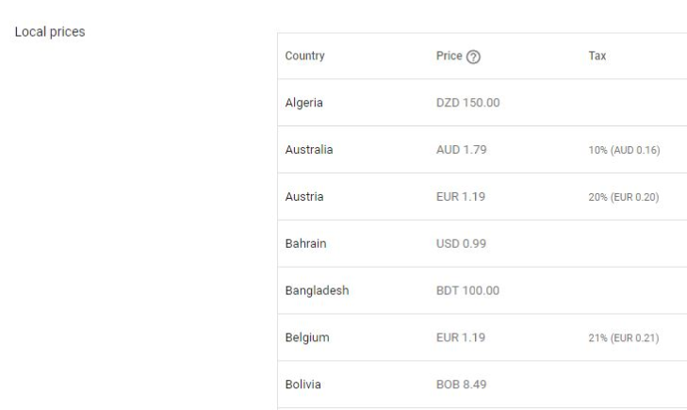
In-App Purchases
Denmark: 25%
France: 20%
Taiwan: 5%
United Stated: 0%

Slide 29
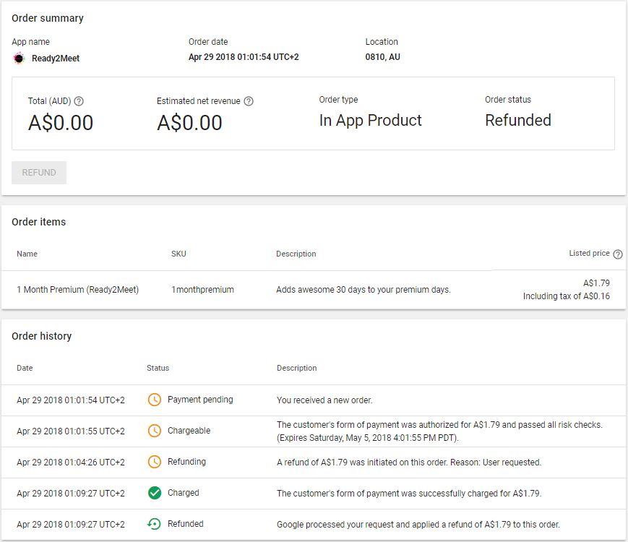
In-App Purchases

Slide 30
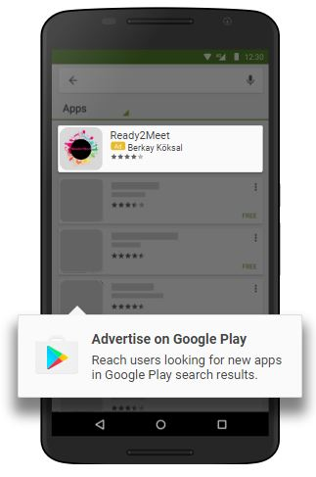
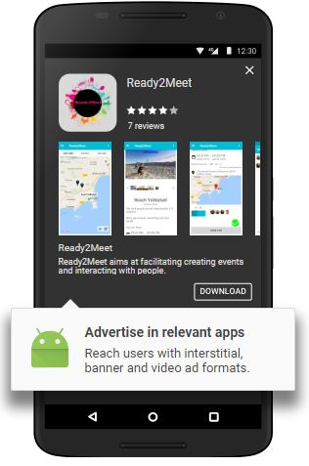
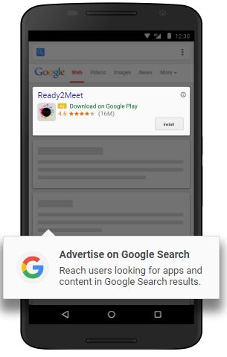
AdWords Campaign

Slide 31
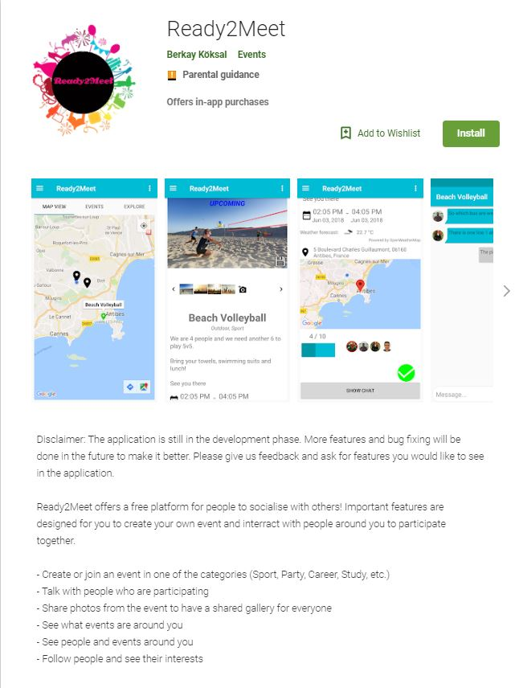
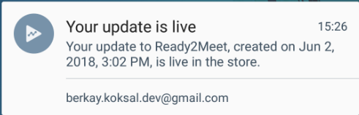
GooglePlay Store Presence

Slide 32

GooglePlay Store Images

Slide 33


Surveys

Slide 34

GooglePlay APK Analyser

Slide 35


Version Management
Production Release
Beta Release
Alpha Release
Internal Test

Slide 36
Technical Details
Permissions:
Internet
Location
Camera
Read and write calendar
GooglePay Billing
Frameworks:
Google Firebase
Google App Engine
Google Map API
OpenWeather API
UI Tools
Glide
Picasso
RoundCornerProgressBar
CircleImageView
CustomCheckBox
MultiSnapRecyclerView
Tools:
Android Studio v3
Github (Private Repo)
Genymotion (Emulator)
Gradle 3.0.1
Facts:
> 50 commits
32 Java classes, > 5500 LoC
56 xml layout files, > 4500 LoC
Node JS for backend, < 100 LoC

Slide 37
Questions?

Slide 38
THANK YOU!
Berkay KÖKSAL

